Slide 1

SIMPLE method for Navier-Stokes equations with implicit time stepping
Mech587 Project #3
Xiaoyu Mao
Notes:
Good morning, Prof Carl, James and Jasmin. Today I will give you a update on my proposal titled a unified Eulerian Variational Framework for multiphase FSI. The focus of this talk will be how to unify the description of the solid and fluid in a fully Eulerian frame of reference, and how to handle the interface in a fixed mesh.

Slide 2



Project 3 Cheat sheet
This is a summary for the equations you need to solve:
1. Predictor for velocity (Take $u$ velocity as an example)
$$\left(\frac{I}{Δt}−\frac{0.5}{Re}\right)u_{k}^{∗}=\frac{I}{Δt}u^{n}−\left(1.5A\left(u^{n}\right)−0.5A\left(u^{n−1}\right)\right)+\frac{0.5}{Re}D\left(u^{n}\right)−δ_{x}(p_{k}^{n})$$
2. Solve for pressure correction (with $u_{k}^{∗},p_{k}^{n}$)
$$−\frac{1}{a}\left(\frac{{p^{′}}_{i+1}−2{p^{′}}_{i}+{p^{′}}_{i−1}}{Δx^{2}}+\frac{{p^{′}}_{j+1}−2{p^{′}}_{j}+{p^{′}}_{j−1}}{Δy^{2}}\right)=−\left(\frac{u_{i+1}^{∗}−u_{i−1}^{∗}}{2Δx}+\frac{p_{i+2}^{n}−4p_{i+1}^{n}+6p_{i}^{n}−4p_{i−1}^{n}+p_{i−2}^{n}}{4a{\left(Δx\right)}^{2}}\right)−\left(\frac{v_{j+1}^{∗}−v_{j−1}^{∗}}{2Δy}+\frac{p_{j+2}^{n}−4p_{j+1}^{n}+6p_{j}^{n}−4p_{j−1}^{n}+p_{j−2}^{n}}{4a{\left(Δy\right)}^{2}}\right)$$
3. Update pressure, solve for new $u^{∗}$
$$p_{k+1}^{n}=p_{k}^{n}+ω_{p}p′$$
$u_{k+1}^{∗}=f(u^{n},p_{k+1}^{n})$ (step 1)
4. After$u_{k+1}^{∗},p_{k+1}^{n}$ converge, which gives value ${u_{c}^{∗},p}_{c}^{n}$, correct velocity
$u^{n+1}=u_{c}^{∗}−\frac{1}{a}\frac{p_{c,i+1}^{′}−p_{c,i−1}^{′}}{2Δx}$, $v^{n+1}=v_{c}^{∗}−\frac{1}{a}\frac{p_{c,j+1}^{′}−p_{c,j−1}^{′}}{2Δy}$,
Where $a=\left(\frac{1}{Δt}+\frac{1}{ReΔx^{2}}+\frac{1}{ReΔy^{2}}\right)$, $ω_{p}=0.7$ is an under-relaxation factor used in this project

Slide 3

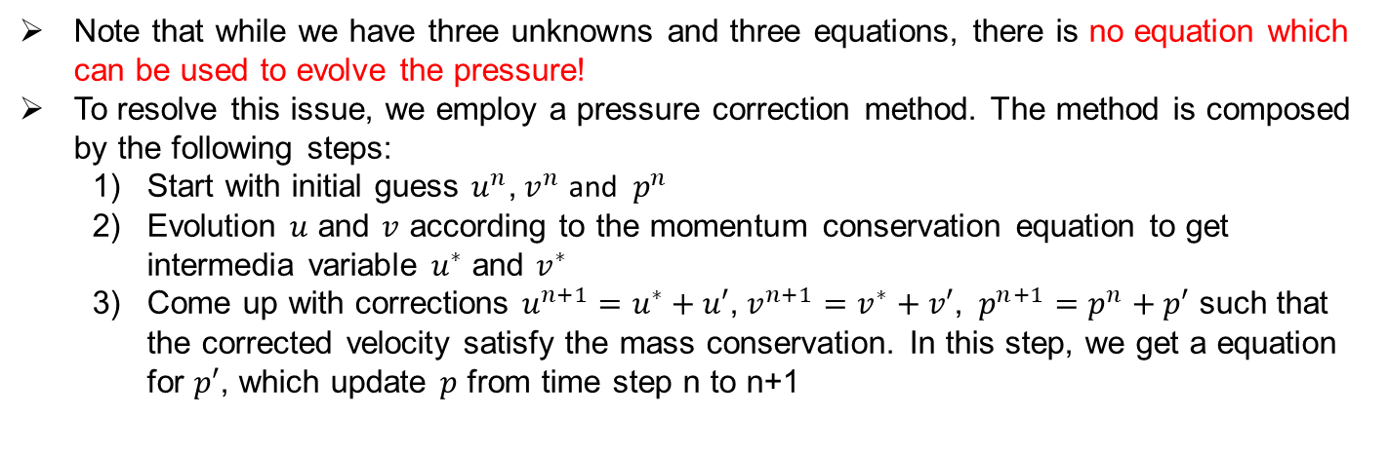


Non-dimensionalized Navier-Stokes Equations
Consider the Navier Stokes equations:
Momentum equation
X-momentum conservation
$$\frac{∂u}{∂t}+u\frac{∂u}{∂x}+v\frac{∂u}{∂y}=−\frac{∂p}{∂x}+\frac{1}{Re}\left(\frac{∂^{2}u}{∂x^{2}}+\frac{∂^{2}u}{∂y^{2}}\right)$$
Y-momentum conservation
$$\frac{∂v}{∂t}+u\frac{∂v}{∂x}+v\frac{∂v}{∂y}=−\frac{∂p}{∂y}+\frac{1}{Re}\left(\frac{∂^{2}v}{∂x^{2}}+\frac{∂^{2}v}{∂y^{2}}\right)$$
Mass conservation
$$\frac{∂u}{∂x}+\frac{∂v}{∂y}=0$$
Where $Re=\frac{ρUL}{μ}$ is the Reynolds number. $U$ is a characteristic velocity which is a constant
Note that while we have three unknowns and three equations, there is no equation which can be used to evolve the pressure!
To resolve this issue, we employ a pressure correction method. The method is composed by the following steps:
Start with initial guess $u^{n}$, $v^{n}$ and $p^{n}$
Evolution $u$ and $v$ according to the momentum conservation equation to get intermedia variable $u^{∗}$ and $v^{∗}$
Come up with corrections $u^{n+1}=u^{∗}+u′$, $v^{n+1}=v^{∗}+v′$, $p^{n+1}=p^{n}+p′$ such that the corrected velocity satisfy the mass conservation. In this step, we get a equation for $p′$, which update $p$ from time step n to n+1
Notes:
First, let me introduce the context of my research topic. The current research topic is motivated by the intelligent and green marine vessel proposal. We focus on the development of tools which make the marine vessels intelligent and environmentally friendly. Combining the high-fidelity model-based simulation and data driven techniques, we want to make the design and operation of the next generation marine vessels more interactive, automized, efficient and green. My focus is to reduce the noise of the ship and its harm to the marine mammals. This requires high fidelity simulation of multiphase fluid structure interaction.

Slide 4

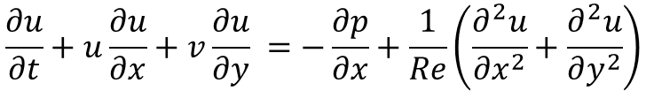
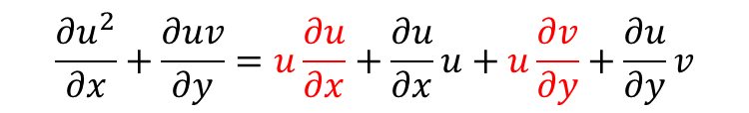
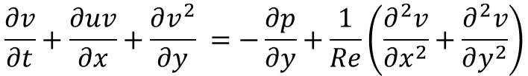
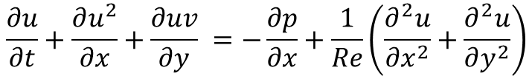
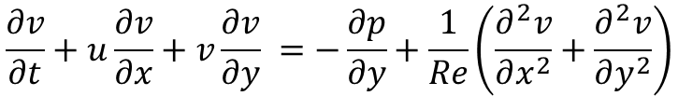
Step 1: Prediction
With initial guess $u^{n}$, $v^{n}$ and $p^{n}$, we want to evolve $u$ and $v$ according to the momentum conservation equation to get intermedia variable $u^{∗}$ and $v^{∗}$
X-momentum conservation
$$\frac{∂u}{∂t}+u\frac{∂u}{∂x}+v\frac{∂u}{∂y} =−\frac{∂p}{∂x}+\frac{1}{Re}\left(\frac{∂^{2}u}{∂x^{2}}+\frac{∂^{2}u}{∂y^{2}}\right)$$
Y-momentum conservation
$$\frac{∂v}{∂t}+u\frac{∂v}{∂x}+v\frac{∂v}{∂y} =−\frac{∂p}{∂y}+\frac{1}{Re}\left(\frac{∂^{2}v}{∂x^{2}}+\frac{∂^{2}v}{∂y^{2}}\right)$$
We want to solve the equation in conservative form:
X-momentum conservation
$$\frac{∂u}{∂t}+\frac{∂u^{2}}{∂x}+\frac{∂uv}{∂y} =−\frac{∂p}{∂x}+\frac{1}{Re}\left(\frac{∂^{2}u}{∂x^{2}}+\frac{∂^{2}u}{∂y^{2}}\right)$$
Y-momentum conservation
$$\frac{∂v}{∂t}+\frac{∂uv}{∂x}+\frac{∂v^{2}}{∂y} =−\frac{∂p}{∂y}+\frac{1}{Re}\left(\frac{∂^{2}v}{∂x^{2}}+\frac{∂^{2}v}{∂y^{2}}\right)$$
The equivalence of these two forms can be derived by:
$$\frac{∂u^{2}}{∂x}+\frac{∂uv}{∂y}=u\frac{∂u}{∂x}+\frac{∂u}{∂x}u+u\frac{∂v}{∂y}+\frac{∂u}{∂y}v$$
$$u\frac{∂u}{∂x}+u\frac{∂v}{∂y}=u\left(\frac{∂u}{∂x}+\frac{∂v}{∂y}\right)=0$$
Due to mass conservation,

Slide 5











Conservative form
We want to solve the equation in conservative form:
X-momentum conservation
$$\frac{∂u}{∂t}+\frac{∂u^{2}}{∂x}+\frac{∂uv}{∂y} =−\frac{∂p}{∂x}+\frac{1}{Re}\left(\frac{∂^{2}u}{∂x^{2}}+\frac{∂^{2}u}{∂y^{2}}\right)$$
Y-momentum conservation
$$\frac{∂v}{∂t}+\frac{∂uv}{∂x}+\frac{∂v^{2}}{∂y} =−\frac{∂p}{∂y}+\frac{1}{Re}\left(\frac{∂^{2}v}{∂x^{2}}+\frac{∂^{2}v}{∂y^{2}}\right)$$
The conservation at the numerical level can be proved by rearranging the equation as:
$$\frac{∂u}{∂t}+\frac{∂}{∂x}\left(u^{2}+p−\frac{1}{Re}\frac{∂u}{∂x }\right)+\frac{∂}{∂y}\left(uv−\frac{1}{Re}\frac{∂u}{∂y }\right)=0$$
$$j+1$$
$$j+\frac{1}{2}$$
$$\frac{∂v}{∂t}+\frac{∂}{∂x}\left(uv−\frac{1}{Re}\frac{∂v}{∂x }\right)+\frac{∂}{∂y}\left(v^{2}+p−\frac{1}{Re}\frac{∂u}{∂y }\right)=0$$
$$i−1$$
$$i−\frac{1}{2}$$
$$i+\frac{1}{2}$$
$$(i,j)$$
$$i+1$$
And consider the integration in the control volume enclosed by the dashed line:
$$j−\frac{1}{2}$$
1D demonstration is provided in handout 5 with regard to why it is conservative.
$$j−1$$

Slide 6





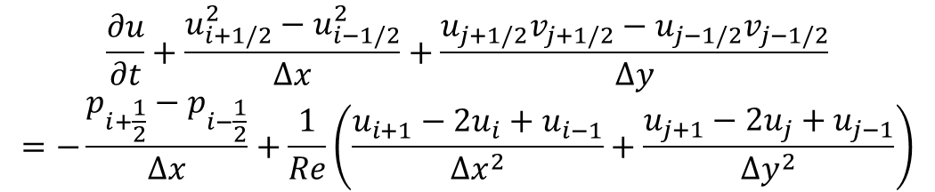













Spatial discretization
$$j+1$$
$$j+\frac{1}{2}$$
For X-Momentum equation:
$$\frac{∂u}{∂t}+\frac{∂u^{2}}{∂x}+\frac{∂uv}{∂y}=−\frac{∂p}{∂x}+\frac{1}{Re}\left(\frac{∂^{2}u}{∂x^{2}}+\frac{∂^{2}u}{∂y^{2}}\right)$$
$$i−\frac{1}{2}$$
$$i+\frac{1}{2}$$
$$i−1$$
$$(i,j)$$
$$i+1$$
$$j−\frac{1}{2}$$
$$\frac{∂u}{∂t}+\frac{u_{i+1/2}^{2}−u_{i−1/2}^{2}}{Δx}+\frac{u_{j+1/2}v_{j+1/2}−u_{j−1/2}v_{j−1/2}}{Δy}$$
$$=−\frac{p_{i+\frac{1}{2}}−p_{i−\frac{1}{2}}}{Δx}+\frac{1}{Re}\left(\frac{u_{i+1}−2u_{i}+u_{i−1}}{Δx^{2}}+\frac{u_{j+1}−2u_{j}+u_{j−1}}{Δy^{2}}\right)$$
$$j−1$$
where
$$u_{i+1/2}=0.5(u_{i+1}+u_{i})$$
$$u_{i−1/2}=0.5(u_{i}+u_{i−1})$$
$$u_{j+1/2}=0.5(u_{j+1}+u_{j})$$
$$u_{j−1/2}=0.5(u_{j}+u_{j−1})$$
(1)
$$v_{j+1/2}=0.5(v_{j+1}+v_{j})$$
$$v_{j−1/2}=0.5(v_{j}+v_{j−1})$$
$$p_{i+1/2}=0.5(p_{i+1}+p_{i})$$
$$p_{i−1/2}=0.5(p_{i}+p_{i−1})$$
Note that all these data at half is intermediate. We only store $u,v,p$ at positions with integer index
Similar equation can be derived for Y-momentum conservation:

Slide 7
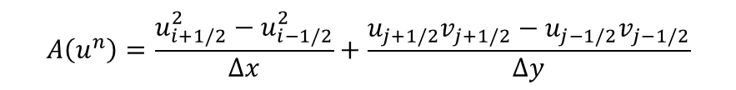

Temporal discretization
Following the Project 2, we use a implicit/explicit scheme
Adam-Bathforth 2 for convection
Trapezoidal for diffusion
For X-Momentum equation:
$$\frac{∂u}{∂t}+\frac{u_{i+1/2}^{2}−u_{i−1/2}^{2}}{Δx}+\frac{u_{j+1/2}v_{j+1/2}−u_{j−1/2}v_{j−1/2}}{Δy}=−\frac{p_{i+\frac{1}{2}}−p_{i−\frac{1}{2}}}{Δx}+\frac{1}{Re}\left(\frac{u_{i+1}−2u_{i}+u_{i−1}}{Δx^{2}}+\frac{u_{j+1}−2u_{j}+u_{j−1}}{Δy^{2}}\right)$$
$$A\left(u^{n}\right)=\frac{u_{i+1/2}^{2}−u_{i−1/2}^{2}}{Δx}+\frac{u_{j+1/2}v_{j+1/2}−u_{j−1/2}v_{j−1/2}}{Δy}$$
Denote
with all the velocities from time step of n
$$D\left(u^{n}\right)=\frac{u_{i+1}−2u_{i}+u_{i−1}}{Δx^{2}}+\frac{u_{j+1}−2u_{j}+u_{j−1}}{Δy^{2}}$$
with all the velocities from time step of n
$$δ_{x}\left(p^{n}\right)=\frac{p_{i+1/2}^{n}−p_{i−1/2}^{n}}{Δx}$$
with all the pressure from time step of n
$$\frac{1}{Δt}\left(u_{i,j}^{∗}−u_{i,j}^{n}\right)=−\left(1.5A\left(u^{n}\right)−0.5A\left(u^{n−1}\right)\right)+\frac{0.5}{Re}D\left(u^{n}\right)+\frac{0.5}{Re}D\left(u^{∗}\right)−δ_{x}(p^{n})$$
We have:
Matrix form:
$$\left(\frac{I}{Δt}−\frac{0.5}{Re}\right)u^{∗}=\frac{I}{Δt}u^{n}−\left(1.5A\left(u^{n}\right)−0.5A\left(u^{n−1}\right)\right)+\frac{0.5}{Re}D\left(u^{n}\right)−δ_{x}(p^{n})$$
(2)
Y-momentum equation can be solved in a similar manner.
You can solve it in exactly the same way with solving the project 2 to get $u^{∗},v^{∗}$.

Slide 8
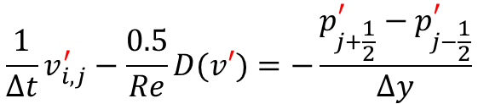
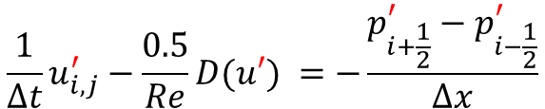
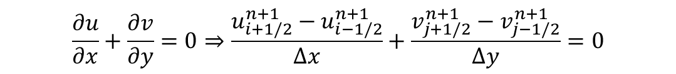
Step 2: Correction
From the prediction step :
$$\frac{1}{Δt}\left(u_{i,j}^{∗}−u_{i,j}^{n}\right)=−\left(1.5A\left(u^{n}\right)−0.5A\left(u^{n−1}\right)\right)+\frac{0.5}{Re}D\left(u^{n}\right)+\frac{0.5}{Re}D\left(u^{∗}\right)−\frac{p_{i+\frac{1}{2}}^{n}−p_{i−\frac{1}{2}}^{n}}{Δx}$$
(3)
We are hoping that after correction :
$$\frac{1}{Δt}\left(u_{i,j}^{n+1}−u_{i,j}^{n}\right)=−\left(1.5A\left(u^{n}\right)−0.5A\left(u^{n−1}\right)\right)+\frac{0.5}{Re}D\left(u^{n}\right)+\frac{0.5}{Re}D\left(u^{n+1}\right)−\frac{p_{i+\frac{1}{2}}^{n+1}−p_{i−\frac{1}{2}}^{n+1}}{Δx}$$
(4)
(4) – (3), we have the equation for the correction:
$$\frac{1}{Δt}u_{i,j}^{′}−\frac{0.5}{Re}D(u′) =−\frac{p_{i+\frac{1}{2}}^{′}−p_{i−\frac{1}{2}}^{′}}{Δx}$$
$$\frac{1}{Δt}v_{i,j}^{′}−\frac{0.5}{Re}D(v′)=−\frac{p_{j+\frac{1}{2}}^{′}−p_{j−\frac{1}{2}}^{′}}{Δy}$$
(5)
where
$$u^{∗}+u^{′}=u^{n+1}$$
$$p^{n}+p^{′}=p^{n+1}$$
$$v^{∗}+v^{′}=v^{n+1}$$
The corrected velocities should satisfy
$$\frac{∂u}{∂x}+\frac{∂v}{∂y}=0⇒\frac{u_{i+1/2}^{n+1}−u_{i−1/2}^{n+1}}{Δx}+\frac{v_{j+1/2}^{n+1}−v_{j−1/2}^{n+1}}{Δy}=0$$
(6)

Slide 9

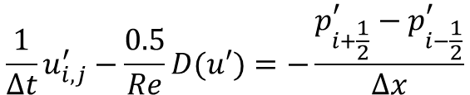
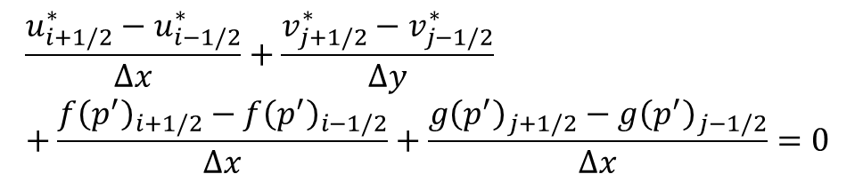
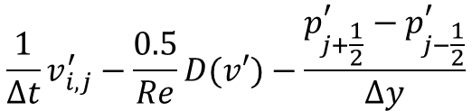
Step 2: Correction
Expand (6), we have:
$$\frac{u_{i+1/2}^{∗}−u_{i−1/2}^{∗}}{Δx}+\frac{v_{j+1/2}^{∗}−v_{j−1/2}^{∗}}{Δy}+\frac{u_{i+1/2}^{′}−u_{i−1/2}^{′}}{Δx}+\frac{v_{j+1/2}^{′}−v_{j−1/2}^{′}}{Δy}=0$$
(7)
Where $u^{∗}$, $v^{∗}$ is known. With equation (5):
$$\frac{1}{Δt}u_{i,j}^{′}−\frac{0.5}{Re}D(u′)=−\frac{p_{i+\frac{1}{2}}^{′}−p_{i−\frac{1}{2}}^{′}}{Δx}$$
$$\frac{1}{Δt}v_{i,j}^{′}−\frac{0.5}{Re}D(v′)−\frac{p_{j+\frac{1}{2}}^{′}−p_{j−\frac{1}{2}}^{′}}{Δy}$$
If we can write equation (5) as $u^{′}=f\left(p^{′}\right),v^{′}=g\left(p^{′}\right)$, substitute into equation (7), we have:
$$\frac{u_{i+1/2}^{∗}−u_{i−1/2}^{∗}}{Δx}+\frac{v_{j+1/2}^{∗}−v_{j−1/2}^{∗}}{Δy}+\frac{f{\left(p^{′}\right)}_{i+1/2}−f{\left(p^{′}\right)}_{i−1/2}}{Δx}+\frac{g{\left(p^{′}\right)}_{j+1/2}−g{\left(p^{′}\right)}_{j−1/2}}{Δx}=0$$
(8)
Where $u^{∗}$, $v^{∗}$ known, we can solve equation (8) for $p′$.
Then, with $p′$ solved, we can solve equation (5) for $u′$ and $v′$.
Then, we can update the solution with
$$u^{∗}+u^{′}=u^{n+1}$$
$$p^{n}+p^{′}=p^{n+1}$$
$$v^{∗}+v^{′}=v^{n+1}$$

Slide 10
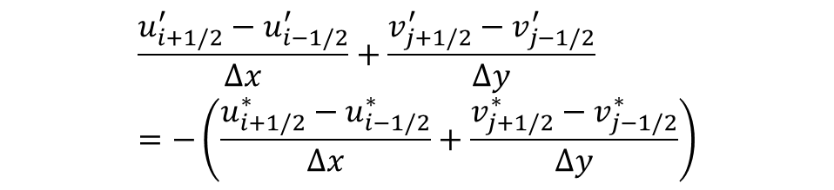

Step 2: Correction
Now let’s focus on equation (7). We have several technique details to discuss.
$$\frac{u_{i+1/2}^{′}−u_{i−1/2}^{′}}{Δx}+\frac{v_{j+1/2}^{′}−v_{j−1/2}^{′}}{Δy}=−\left(\frac{u_{i+1/2}^{∗}−u_{i−1/2}^{∗}}{Δx}+\frac{v_{j+1/2}^{∗}−v_{j−1/2}^{∗}}{Δy}\right)$$
(9)
How to get $u^{′}=f(p′)$ and $v^{′}=g\left(p^{′}\right)$?
With $u^{∗}$ and $v^{∗}$ known at the positions with integer index, how to interpolate for values at half location?

Slide 11
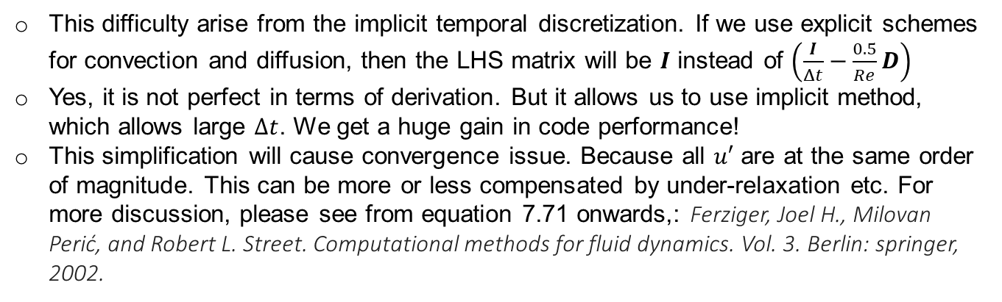
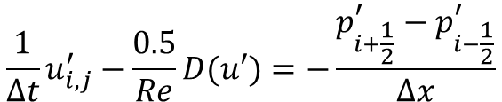
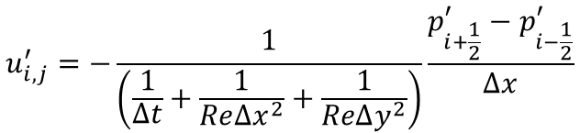
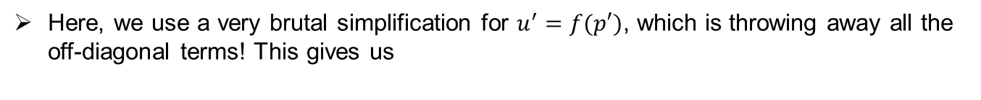
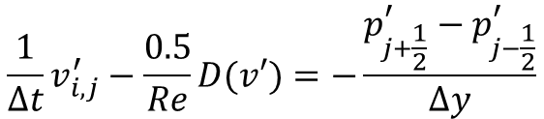
Elimination for implicit temporal discretization
For $u^{′}=f(p′)$ and $v^{′}=g\left(p^{′}\right)$, we need to look into the linear system (5):
$$\frac{1}{Δt}u_{i,j}^{′}−\frac{0.5}{Re}D(u′)=−\frac{p_{i+\frac{1}{2}}^{′}−p_{i−\frac{1}{2}}^{′}}{Δx}$$
$$\frac{1}{Δt}v_{i,j}^{′}−\frac{0.5}{Re}D(v′)=−\frac{p_{j+\frac{1}{2}}^{′}−p_{j−\frac{1}{2}}^{′}}{Δy}$$
which gives us:
$$−\frac{1}{2ReΔx^{2}}u_{i−1}^{′}−\frac{1}{2Δ{Rey}^{2}}u_{j−1}^{′}+\left(\frac{1}{Δt}+\frac{1}{ReΔx^{2}}+\frac{1}{ReΔy^{2}}\right)u_{i,j}^{′}−\frac{1}{2ReΔy^{2}}u_{j+1}^{′}−\frac{1}{2ReΔx^{2}}u_{i+1}^{′}=−\frac{p_{i+\frac{1}{2}}^{′}−p_{i−\frac{1}{2}}^{′}}{Δx}$$
Here, we use a very brutal simplification for $u^{′}=f(p′)$, which is throwing away all the off-diagonal terms! This gives us
$$u_{i,j}^{′}=−\frac{1}{\left(\frac{1}{Δt}+\frac{1}{ReΔx^{2}}+\frac{1}{ReΔy^{2}}\right)}\frac{p_{i+\frac{1}{2}}^{′}−p_{i−\frac{1}{2}}^{′}}{Δx}$$
(10)
Discussions:
This difficulty arise from the implicit temporal discretization. If we use explicit schemes for convection and diffusion, then the LHS matrix will be $I$ instead of $\left(\frac{I}{Δt}−\frac{0.5}{Re}D\right)$
Yes, it is not perfect in terms of derivation. But it allows us to use implicit method, which allows large $Δt$. We get a huge gain in code performance!
This simplification will cause convergence issue. Because all $u′$ are at the same order of magnitude. This can be more or less compensated by under-relaxation etc. For more discussion, please see from equation 7.71 onwards,: Ferziger, Joel H., Milovan Perić, and Robert L. Street. Computational methods for fluid dynamics. Vol. 3. Berlin: springer, 2002.

Slide 12
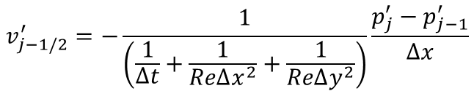
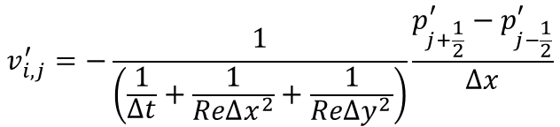
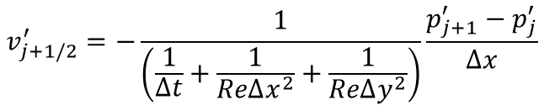
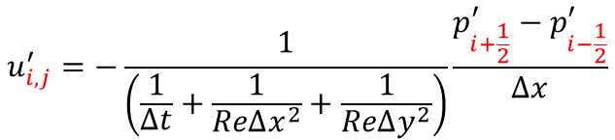
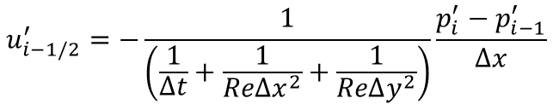
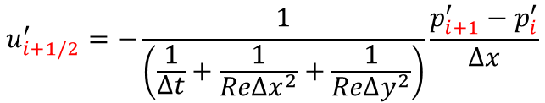

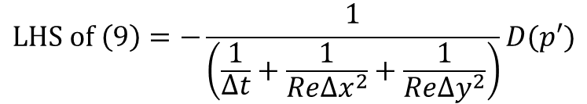
Elimination for implicit temporal discretization
Now we have equation (10):
$$u_{i,j}^{′}=−\frac{1}{\left(\frac{1}{Δt}+\frac{1}{ReΔx^{2}}+\frac{1}{ReΔy^{2}}\right)}\frac{p_{i+\frac{1}{2}}^{′}−p_{i−\frac{1}{2}}^{′}}{Δx}$$
$$v_{i,j}^{′}=−\frac{1}{\left(\frac{1}{Δt}+\frac{1}{ReΔx^{2}}+\frac{1}{ReΔy^{2}}\right)}\frac{p_{j+\frac{1}{2}}^{′}−p_{j−\frac{1}{2}}^{′}}{Δx}$$
However, the LHS of equation (9), we need $u_{i±1/2}^{′}$ and $v_{j±1/2}^{.′}$. We use:
$$u_{i+1/2}^{′}=−\frac{1}{\left(\frac{1}{Δt}+\frac{1}{ReΔx^{2}}+\frac{1}{ReΔy^{2}}\right)}\frac{p_{i+1}^{′}−p_{i}^{′}}{Δx}$$
$$u_{i−1/2}^{′}=−\frac{1}{\left(\frac{1}{Δt}+\frac{1}{ReΔx^{2}}+\frac{1}{ReΔy^{2}}\right)}\frac{p_{i}^{′}−p_{i−1}^{′}}{Δx}$$
$$v_{j+1/2}^{′}=−\frac{1}{\left(\frac{1}{Δt}+\frac{1}{ReΔx^{2}}+\frac{1}{ReΔy^{2}}\right)}\frac{p_{j+1}^{′}−p_{j}^{′}}{Δx}$$
$$v_{j−1/2}^{′}=−\frac{1}{\left(\frac{1}{Δt}+\frac{1}{ReΔx^{2}}+\frac{1}{ReΔy^{2}}\right)}\frac{p_{j}^{′}−p_{j−1}^{′}}{Δx}$$
Substitute into equation (9), we have:
$$LHS of \left(9\right)=−\frac{1}{\left(\frac{1}{Δt}+\frac{1}{ReΔx^{2}}+\frac{1}{ReΔy^{2}}\right)}D(p′)$$
(11)
where
$$D\left(p^{′}\right)=\frac{{p′}_{i+1}−2{p′}_{i}+{p′}_{i−1}}{Δx^{2}}+\frac{{p′}_{j+1}−2{p′}_{j}+{p′}_{j−1}}{Δy^{2}}$$

Slide 13
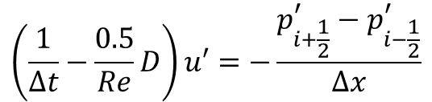
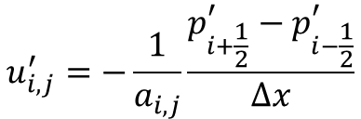

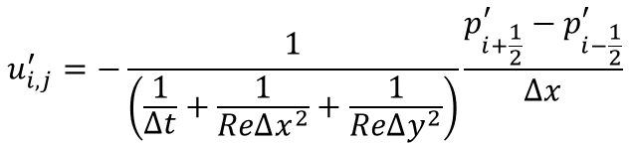

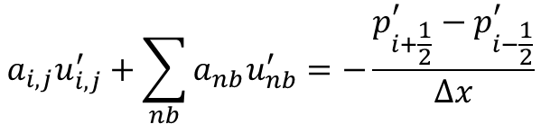
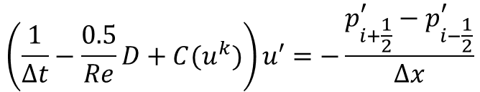
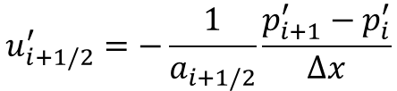
Elimination for implicit temporal discretization
Discussion on the previous slide
And after simplification, we have equation (10):
we have equation (5):
$$\left(\frac{1}{Δt}−\frac{0.5}{Re}D\right)u′=−\frac{p_{i+\frac{1}{2}}^{′}−p_{i−\frac{1}{2}}^{′}}{Δx}$$
$$u_{i,j}^{′}=−\frac{1}{\left(\frac{1}{Δt}+\frac{1}{ReΔx^{2}}+\frac{1}{ReΔy^{2}}\right)}\frac{p_{i+\frac{1}{2}}^{′}−p_{i−\frac{1}{2}}^{′}}{Δx}$$
In case where you discretize the convective term in an implicit manner, you will have
$$\left(\frac{1}{Δt}−\frac{0.5}{Re}D+C(u^{k})\right)u′=−\frac{p_{i+\frac{1}{2}}^{′}−p_{i−\frac{1}{2}}^{′}}{Δx}$$
Still, we can write it as:
And after simplification (throw away $nb$ terms)
$$a_{i,j}u_{i,j}^{′}+\sum_{nb}{a_{nb}u_{nb}^{′}}=−\frac{p_{i+\frac{1}{2}}^{′}−p_{i−\frac{1}{2}}^{′}}{Δx}$$
$$u_{i,j}^{′}=−\frac{1}{a_{i,j}}\frac{p_{i+\frac{1}{2}}^{′}−p_{i−\frac{1}{2}}^{′}}{Δx}$$
Where $nb$ denotes the neighbor points
Note that $a_{i,j}$ now involves $u^{k}$, which is no longer a constant. Now we can have:
$$u_{i+1/2}^{′}=−\frac{1}{a_{i+1/2}}\frac{p_{i+1}^{′}−p_{i}^{′}}{Δx}$$
Where $\frac{1}{a_{i+1/2}}$can be approximated through interpolation:
$$\frac{1}{a_{i+1/2}}=\frac{1}{2}\left(\frac{1}{a_{i}}+\frac{1}{a_{i+1}}\right)$$

Slide 14
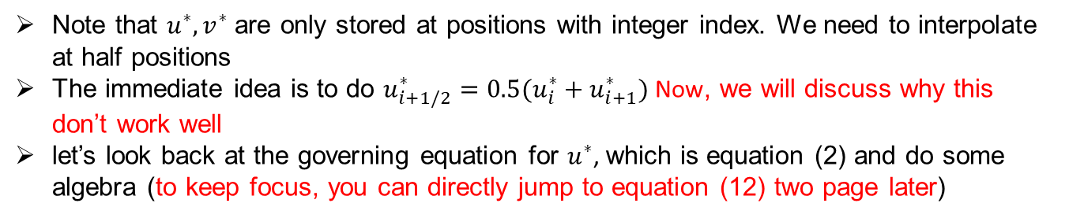

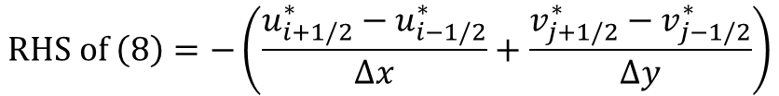

Checkerboard problem
Now let’s focus on the RHS of the equation (9)
$$RHS of \left(8\right)=−\left(\frac{u_{i+1/2}^{∗}−u_{i−1/2}^{∗}}{Δx}+\frac{v_{j+1/2}^{∗}−v_{j−1/2}^{∗}}{Δy}\right)$$
Note that $u^{∗},v^{∗}$ are only stored at positions with integer index. We need to interpolate at half positions
The immediate idea is to do $u_{i+1/2}^{∗}=0.5(u_{i}^{∗}+u_{i+1}^{∗})$ Now, we will discuss why this don’t work well
let’s look back at the governing equation for $u^{∗}$, which is equation (2) and do some algebra (to keep focus, you can directly jump to equation (12) two page later)
$$\frac{1}{Δt}\left(u_{i,j}^{∗}−u_{i,j}^{n}\right)=−\left(1.5A\left(u^{n}\right)−0.5A\left(u^{n−1}\right)\right)+\frac{0.5}{Re}D\left(u^{n}\right)+\frac{0.5}{Re}D\left(u^{∗}\right)−\frac{p_{i+\frac{1}{2}}^{n}−p_{i−\frac{1}{2}}^{n}}{Δx}$$
Rearrange as
$$\frac{I}{Δt}u_{i,j}^{∗}−\frac{0.5}{Re}D(u^{∗})=\frac{I}{Δt}u^{n}−\left(1.5A\left(u^{n}\right)−0.5A\left(u^{n−1}\right)\right)+\frac{0.5}{Re}D\left(u^{n}\right)−\frac{p_{i+\frac{1}{2}}^{n}−p_{i−\frac{1}{2}}^{n}}{Δx}$$
$$a_{i,j}u_{i,j}^{∗}+\sum_{nb}{a_{nb}u_{nb}^{∗}}$$
$$b^{n}$$

Slide 15



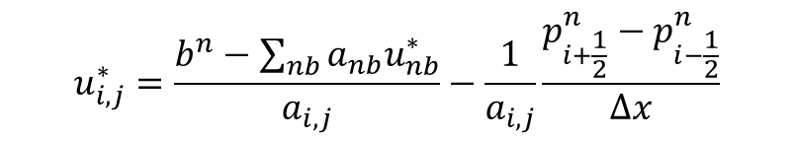
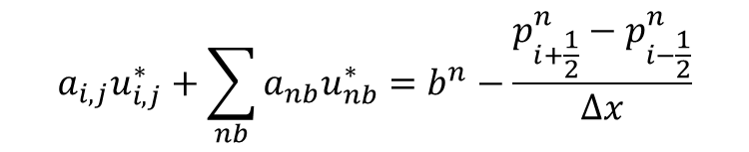
Checkerboard problem
Rearrange as
$$\frac{1}{Δt}u_{i,j}^{∗}−\frac{0.5}{Re}D(u^{∗})=\frac{1}{Δt}u^{n}−\left(1.5A\left(u^{n}\right)−0.5A\left(u^{n−1}\right)\right)+\frac{0.5}{Re}D\left(u^{n}\right)−\frac{p_{i+\frac{1}{2}}^{n}−p_{i−\frac{1}{2}}^{n}}{Δx}$$
$$a_{i,j}u_{i,j}^{∗}+\sum_{nb}{a_{nb}u_{nb}^{∗}}$$
$$b^{n}$$
$$a_{i,j}u_{i,j}^{∗}+\sum_{nb}{a_{nb}u_{nb}^{∗}}=b^{n}−\frac{p_{i+\frac{1}{2}}^{n}−p_{i−\frac{1}{2}}^{n}}{Δx}$$
$$u_{i,j}^{∗}=\frac{b^{n}−\sum_{nb}{a_{nb}u_{nb}^{∗}}}{a_{i,j}}−\frac{1}{a_{i,j}}\frac{p_{i+\frac{1}{2}}^{n}−p_{i−\frac{1}{2}}^{n}}{Δx}$$
$$u_{i,j}^{nb,∗}$$
$$u_{i,j}^{∗}=u_{i,j}^{nb,∗}−\frac{1}{a_{i,j}}\frac{p_{i+\frac{1}{2}}^{n}−p_{i−\frac{1}{2}}^{n}}{Δx}$$

Slide 16







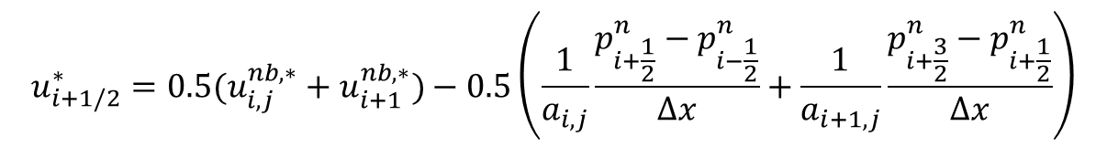


Checkerboard problem
With
$$u_{i,j}^{∗}=u_{i,j}^{nb,∗}−\frac{1}{a_{i,j}}\frac{p_{i+\frac{1}{2}}^{n}−p_{i−\frac{1}{2}}^{n}}{Δx}$$
(12)
If we do interpolation as $u_{i+1/2}^{∗}=0.5(u_{i}^{∗}+u_{i+1}^{∗})$, we reach
$$u_{i+1/2}^{∗}={0.5(u}_{i,j}^{nb,∗}+u_{i+1}^{nb,∗})−0.5\left(\frac{1}{a_{i,j}}\frac{p_{i+\frac{1}{2}}^{n}−p_{i−\frac{1}{2}}^{n}}{Δx}+\frac{1}{a_{i+1,j}}\frac{p_{i+\frac{3}{2}}^{n}−p_{i+\frac{1}{2}}^{n}}{Δx}\right)$$
With current discretization, $a_{i,j}=a_{i+1,j}=\left(\frac{1}{Δt}+\frac{1}{ReΔx^{2}}+\frac{1}{ReΔy^{2}}\right)$ is a constant.
$$u_{i+1/2}^{∗}={0.5(u}_{i,j}^{nb,∗}+u_{i+1}^{nb,∗})−\frac{1}{\left(\frac{1}{Δt}+\frac{1}{ReΔx^{2}}+\frac{1}{ReΔy^{2}}\right)}\left(\frac{p_{i+\frac{3}{2}}^{n}−p_{i−\frac{1}{2}}^{n}}{2Δx}\right)$$
See 1D stencil,
$$p_{i−\frac{1}{2}}^{n}$$
$$p_{i+\frac{3}{2}}^{n}$$
$$u_{i+1/2}^{∗}$$
$$i−\frac{1}{2}$$
$$i$$
$$i+\frac{1}{2}$$
$$i+\frac{3}{2}$$
$$i+1$$

Slide 17








Checkerboard problem
With current discretization, $a_{i,j}=a_{i+1,j}=\left(\frac{1}{Δt}+\frac{1}{ReΔx^{2}}+\frac{1}{ReΔy^{2}}\right)$ is a constant.
$$u_{i+1/2}^{∗}={0.5(u}_{i,j}^{nb,∗}+u_{i+1}^{nb,∗})−\frac{1}{\left(\frac{1}{Δt}+\frac{1}{ReΔx^{2}}+\frac{1}{ReΔy^{2}}\right)}\left(\frac{p_{i+\frac{3}{2}}^{n}−p_{i−\frac{1}{2}}^{n}}{2Δx}\right)$$
See 1D stencil,
$$p_{i−\frac{1}{2}}^{n}$$
$$u_{i+1/2}^{∗}$$
$$p_{i+\frac{3}{2}}^{n}$$
$$i−\frac{1}{2}$$
$$i$$
$$i+\frac{1}{2}$$
$$i+\frac{3}{2}$$
$$i+1$$
It is equivalent to solve pressure in a mesh which is one level coarser than the current grid! Which leads to bad coupling between the pressure and velocity.
This is referred to as the checkerboard problem

Slide 18










Checkerboard problem
$$u_{i+1/2}^{∗}={0.5(u}_{i,j}^{nb,∗}+u_{i+1}^{nb,∗})−\frac{1}{\left(\frac{1}{Δt}+\frac{1}{ReΔx^{2}}+\frac{1}{ReΔy^{2}}\right)}\left(\frac{p_{i+\frac{3}{2}}^{n}−p_{i−\frac{1}{2}}^{n}}{2Δx}\right)$$
For the current equation
To further demonstrate the problem, suppose we have the following pressure distribution:
$$p=$$
$$80$$
$$40$$
$$80$$
$$40$$
$$i−3/2$$
$$i−1/2$$
$$i+1/2$$
$$i+3/2$$
If you check this pressure field, while it is oscillator and should produce flow motion due to pressure gradient, with the lose coupling nothing is going to happen!
Observation: the checkerboard problem is introduced immediately when the pressure is considered and we are taking average for half locations

Slide 19
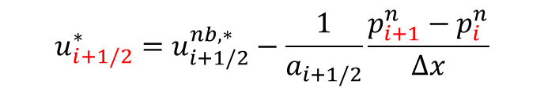
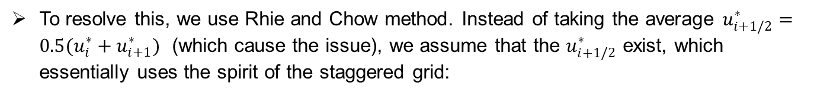


Rhie-Chow correction
To resolve this, we use Rhie and Chow method. Instead of taking the average $u_{i+1/2}^{∗}=0.5(u_{i}^{∗}+u_{i+1}^{∗})$ (which cause the issue), we assume that the $u_{i+1/2}^{∗}$ exist, which essentially uses the spirit of the staggered grid:
$$u_{i+1/2}^{∗}=u_{i+1/2}^{nb,∗}−\frac{1}{a_{i+1/2}}\frac{p_{i+1}^{n}−p_{i}^{n}}{Δx}$$
And approximate non-existing data $u_{i+1/2}^{nb,∗}$ as:
$$u_{i+1/2}^{nb,∗}={0.5(u}_{i,j}^{nb,∗}+u_{i+1}^{nb,∗})$$
Compare with the averaging algorithm $u_{i+1/2}^{∗}=0.5\left(u_{i}^{∗}+u_{i+1}^{∗}\right)$,
$$u_{i+1/2}^{∗}={0.5(u}_{i,j}^{nb,∗}+u_{i+1}^{nb,∗})−\frac{1}{\left(\frac{1}{Δt}+\frac{1}{ReΔx^{2}}+\frac{1}{ReΔy^{2}}\right)}\left(\frac{p_{i+\frac{3}{2}}^{n}−p_{i−\frac{1}{2}}^{n}}{2Δx}\right)$$
the checkerboard problem is gone
Essentially, we are offsetting the steps of involving pressure and taking average

Slide 20
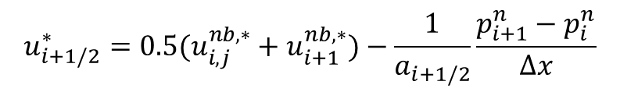
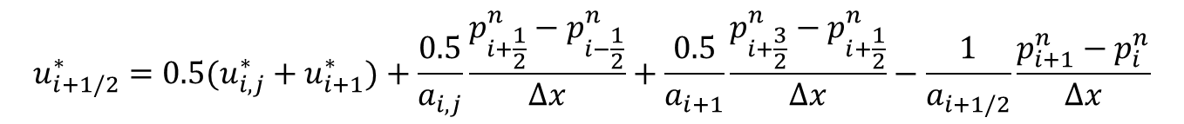


Rhie-Chow correction
Now let’s do some algebra. According to the explanation provided just now, what we end up with is:
$$u_{i+1/2}^{∗}={0.5(u}_{i,j}^{nb,∗}+u_{i+1}^{nb,∗})−\frac{1}{a_{i+1/2}}\frac{p_{i+1}^{n}−p_{i}^{n}}{Δx}$$
For $u_{i+1}^{nb,∗}$ and $u_{i,j}^{nb,∗}$, from equation (12) we have:
$$u_{i,j}^{nb,∗}=u_{i,j}^{∗}+\frac{1}{a_{i,j}}\frac{p_{i+\frac{1}{2}}^{n}−p_{i−\frac{1}{2}}^{n}}{Δx}$$
$$u_{i+1}^{nb,∗}=u_{i+1}^{∗}+\frac{1}{a_{i+1}}\frac{p_{i+\frac{3}{2}}^{n}−p_{i+\frac{1}{2}}^{n}}{Δx}$$
Substitute and eliminate, we have:
$$u_{i+1/2}^{∗}={0.5(u}_{i,j}^{∗}+u_{i+1}^{∗})+\frac{0.5}{a_{i,j}}\frac{p_{i+\frac{1}{2}}^{n}−p_{i−\frac{1}{2}}^{n}}{Δx}+\frac{0.5}{a_{i+1}}\frac{p_{i+\frac{3}{2}}^{n}−p_{i+\frac{1}{2}}^{n}}{Δx}−\frac{1}{a_{i+1/2}}\frac{p_{i+1}^{n}−p_{i}^{n}}{Δx}$$
In the current discretization, we have $a=a_{i,j}=a_{i+1}=a_{i+1/2}=\left(\frac{1}{Δt}+\frac{1}{ReΔx^{2}}+\frac{1}{ReΔy^{2}}\right)$
As a result:
$$u_{i+1/2}^{∗}={0.5(u}_{i,j}^{∗}+u_{i+1}^{∗})+\frac{1}{a}\frac{0.5p_{i+\frac{3}{2}}^{n}−p_{i+1}^{n}+p_{i}^{n}−0.5p_{i−\frac{1}{2}}^{n}}{Δx}$$

Slide 21

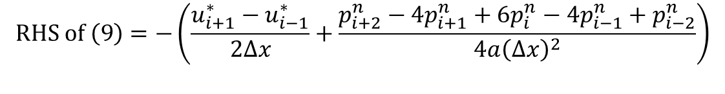

Rhie-Chow correction
Again, data at half location are just intermedia values which doesn’t exist. Recall in equation system (1)
$$p_{i+3/2}=0.5(p_{i+2}+p_{i+1})$$
$$p_{i−1/2}=0.5(p_{i}+p_{i−1})$$
Substitute into the equation:
$$u_{i+1/2}^{∗}={0.5(u}_{i,j}^{∗}+u_{i+1}^{∗})+\frac{1}{a}\frac{0.5p_{i+\frac{3}{2}}^{n}−p_{i+1}^{n}+p_{i}^{n}−0.5p_{i−\frac{1}{2}}^{n}}{Δx}$$
We end up with:
$$u_{i+1/2}^{∗}={0.5(u}_{i,j}^{∗}+u_{i+1}^{∗})+\frac{1}{a}\frac{p_{i+2}^{n}−{3p}_{i+1}^{n}+{3p}_{i}^{n}−p_{i−1}^{n}}{4Δx}$$
Similarly, we can derive $u_{i−1/2}^{∗}$, $v_{i+1/2}^{∗},v_{i−1/2}^{∗}$. Substate them into equation (9), we get:
$$RHS of \left(9\right)=−\left(\frac{u_{i+1}^{∗}−u_{i−1}^{∗}}{2Δx}+\frac{p_{i+2}^{n}−4p_{i+1}^{n}+6p_{i}^{n}−4p_{i−1}^{n}+p_{i−2}^{n}}{4a{\left(Δx\right)}^{2}}\right)$$
$$−\left(\frac{v_{j+1}^{∗}−v_{j−1}^{∗}}{2Δy}+\frac{p_{j+2}^{n}−4p_{j+1}^{n}+6p_{j}^{n}−4p_{j−1}^{n}+p_{j−2}^{n}}{4a{\left(Δy\right)}^{2}}\right)$$

Slide 22
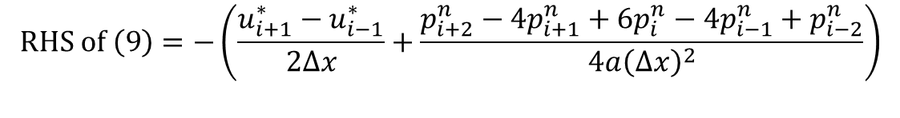
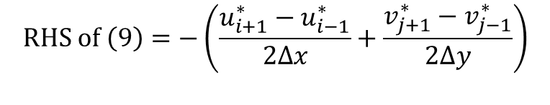
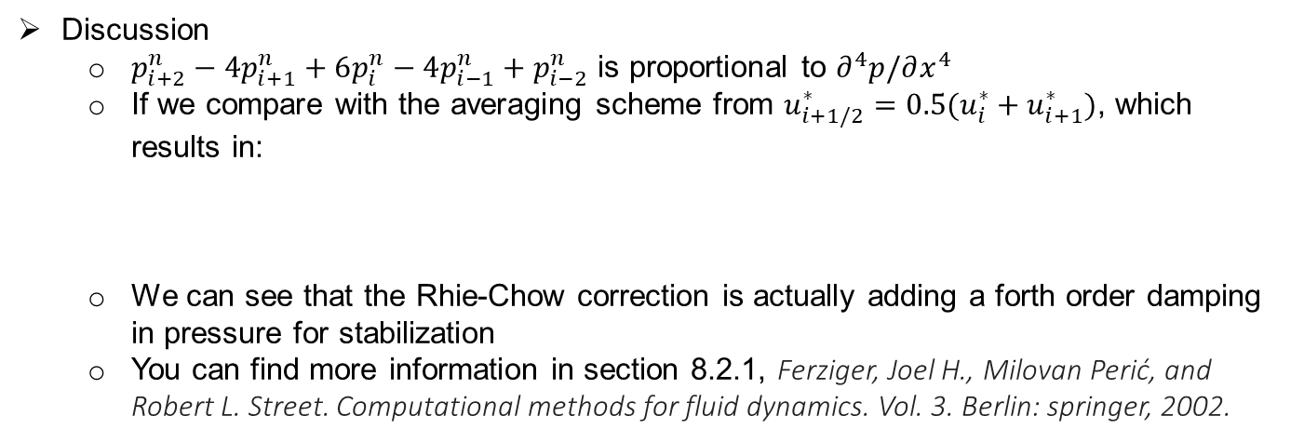

Rhie-Chow correction
At the end, we reach:
$$RHS of \left(9\right)=−\left(\frac{u_{i+1}^{∗}−u_{i−1}^{∗}}{2Δx}+\frac{p_{i+2}^{n}−4p_{i+1}^{n}+6p_{i}^{n}−4p_{i−1}^{n}+p_{i−2}^{n}}{4a{\left(Δx\right)}^{2}}\right)$$
(13)
$$−\left(\frac{v_{j+1}^{∗}−v_{j−1}^{∗}}{2Δy}+\frac{p_{j+2}^{n}−4p_{j+1}^{n}+6p_{j}^{n}−4p_{j−1}^{n}+p_{j−2}^{n}}{4a{\left(Δy\right)}^{2}}\right)$$
Where $a=\left(\frac{1}{Δt}+\frac{1}{ReΔx^{2}}+\frac{1}{ReΔy^{2}}\right)$
Discussion
$p_{i+2}^{n}−4p_{i+1}^{n}+6p_{i}^{n}−4p_{i−1}^{n}+p_{i−2}^{n}$ is proportional to $∂^{4}p/∂x^{4}$
If we compare with the averaging scheme from $u_{i+1/2}^{∗}=0.5(u_{i}^{∗}+u_{i+1}^{∗})$, which results in:
We can see that the Rhie-Chow correction is actually adding a forth order damping in pressure for stabilization
You can find more information in section 8.2.1, Ferziger, Joel H., Milovan Perić, and Robert L. Street. Computational methods for fluid dynamics. Vol. 3. Berlin: springer, 2002.
$$RHS of \left(9\right)=−\left(\frac{u_{i+1}^{∗}−u_{i−1}^{∗}}{2Δx}+\frac{v_{j+1}^{∗}−v_{j−1}^{∗}}{2Δy}\right)$$

Slide 23


Step 2: Correction
Put equation (11) and (13) together, we have the equation for the corrected pressure:
$$−\frac{1}{a}\left(\frac{{p^{′}}_{i+1}−2{p^{′}}_{i}+{p^{′}}_{i−1}}{Δx^{2}}+\frac{{p^{′}}_{j+1}−2{p^{′}}_{j}+{p^{′}}_{j−1}}{Δy^{2}}\right)=−\left(\frac{u_{i+1}^{∗}−u_{i−1}^{∗}}{2Δx}+\frac{p_{i+2}^{n}−4p_{i+1}^{n}+6p_{i}^{n}−4p_{i−1}^{n}+p_{i−2}^{n}}{4a{\left(Δx\right)}^{2}}\right)−\left(\frac{v_{j+1}^{∗}−v_{j−1}^{∗}}{2Δy}+\frac{p_{j+2}^{n}−4p_{j+1}^{n}+6p_{j}^{n}−4p_{j−1}^{n}+p_{j−2}^{n}}{4a{\left(Δy\right)}^{2}}\right)$$
(14)
Where $a=\left(\frac{1}{Δt}+\frac{1}{ReΔx^{2}}+\frac{1}{ReΔy^{2}}\right)$
You can solve it in exactly the same way with solving the project 1.

Slide 24
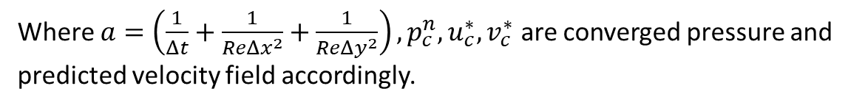




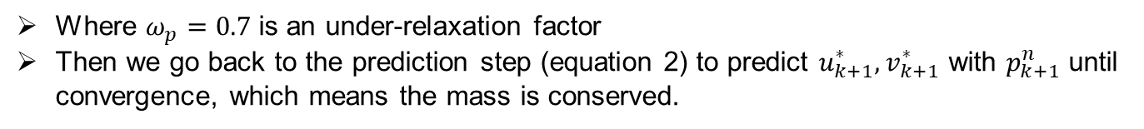

Step 3: Update
We update the pressure as:
$p_{k+1}^{n}=p_{k}^{n}+ω_{p}p′$
Where $ω_{p}=0.7$ is an under-relaxation factor
Then we go back to the prediction step (equation 2) to predict $u_{k+1}^{∗},v_{k+1}^{∗}$ with $p_{k+1}^{n}$ until convergence, which means the mass is conserved.
Lastly, we proceed in time according to equation (10):
$$u_{i,j}^{′}=−\frac{1}{a}\frac{p_{i+\frac{1}{2}}^{′}−p_{i−\frac{1}{2}}^{′}}{Δx}$$
$$v_{i,j}^{′}=−\frac{1}{a}\frac{p_{j+\frac{1}{2}}^{′}−p_{j−\frac{1}{2}}^{′}}{Δy}$$
where
$$p_{i+1/2}^{′}=0.5\left(p_{i+1}^{′}+p_{i}^{′}\right),p_{i−1/2}^{′}=0.5\left(p_{i}^{′}+p_{i−1}^{′}\right),p_{j+1/2}^{′}=0.5\left(p_{j+1}^{′}+p_{j}^{′}\right),p_{j−1/2}^{′}=0.5(p_{j}^{′}+p_{j−1}^{′})$$
We have explicit equations for $u′$ and $v′$:
$$u_{i,j}^{′}=−\frac{1}{a}\frac{p_{i+1}^{′}−p_{i−1}^{′}}{2Δx}$$
$$v_{i,j}^{′}=−\frac{1}{a}\frac{p_{j+1}^{′}−p_{j−1}^{′}}{2Δy}$$
$u^{n+1}=u_{c}^{∗}+u′$, $v^{n+1}=v_{c}^{∗}+v′$,$p^{n+1}=p_{c}^{n}+ω_{p}p′$
Where $a=\left(\frac{1}{Δt}+\frac{1}{ReΔx^{2}}+\frac{1}{ReΔy^{2}}\right),p_{c}^{n},u_{c}^{∗},v_{c}^{∗}$ are converged pressure and predicted velocity field accordingly.

Slide 25



Boundary condition
In this project, we use wall boundary condition for all boundaries:
$$u=v=u^{′}=v^{′}=0$$
on all the boundaries
The complexity lies on the boundary condition for equation (14)
The equation can be used for all interior nodes far from the boundary
$$−\frac{1}{a}\left(\frac{{p^{′}}_{i+1}−2{p^{′}}_{i}+{p^{′}}_{i−1}}{Δx^{2}}+\frac{{p^{′}}_{j+1}−2{p^{′}}_{j}+{p^{′}}_{j−1}}{Δy^{2}}\right)=−\left(\frac{u_{i+1}^{∗}−u_{i−1}^{∗}}{2Δx}+\frac{p_{i+2}^{n}−4p_{i+1}^{n}+6p_{i}^{n}−4p_{i−1}^{n}+p_{i−2}^{n}}{4a{\left(Δx\right)}^{2}}\right)−\left(\frac{v_{j+1}^{∗}−v_{j−1}^{∗}}{2Δy}+\frac{p_{j+2}^{n}−4p_{j+1}^{n}+6p_{j}^{n}−4p_{j−1}^{n}+p_{j−2}^{n}}{4a{\left(Δy\right)}^{2}}\right)$$
$$i=2,3,⋯Nx−3,j=2,3,⋯Ny−3,$$

Slide 26
Boundary condition
Wall Nodes
Corner nodes
Periphery nodes
Interior nodes
Decoupled nodes
Dirichlet Nodes

Slide 27


Boundary condition for wall nodes
On the boundary point
$i=0, i=nx−1$ $j=0, j=ny−1$
For wall boundary condition, we have $u^{n}=v^{n}=u^{n+1}=v^{n+1}=0$
Therefore $u^{′}=v^{′}=0$
According to equation (10), we have:
We approximate
As a crude approximation, we shift the grid by 0.5:
Which is the Neumann boundary condition
Similarly, we have
$$u_{1,j}^{′}=−\frac{1}{\left(\frac{1}{Δt}+\frac{1}{ReΔx^{2}}+\frac{1}{ReΔy^{2}}\right)}\frac{p_{0.5,j}^{′}−p_{−0.5,j}^{′}}{Δx}=0$$
$$p_{0.5,j}^{′}−p_{−0.5,j}^{′}=0$$
$$p_{1,j}^{′}−p_{0,j}^{′}=0$$
$${p_{i,1}^{′}−p_{i,0}^{′}=0 p}_{nx−1,j}^{′}−p_{nx−2,j}^{′}=0,p_{i,ny−1}^{′}−p_{i,ny−2}^{′}=0$$

Slide 28







Boundary condition for Periphery/corner nodes
Following the same procedure, now we have:
wall
$$0$$
$$0.5$$
$$1$$
$$u_{1.5}^{′}=−\frac{1}{\left(\frac{1}{Δt}+\frac{1}{ReΔx^{2}}+\frac{1}{ReΔy^{2}}\right)}\frac{p_{2}^{′}−p_{1}^{′}}{Δx}$$
$$u_{0.5}^{′}=−\frac{1}{2\left(\frac{1}{Δt}+\frac{1}{ReΔx^{2}}+\frac{1}{ReΔy^{2}}\right)}\frac{p_{1}^{′}−p_{0}^{′}}{Δx}=0$$
$$v_{1,j+1/2}^{′}=−\frac{1}{\left(\frac{1}{Δt}+\frac{1}{ReΔx^{2}}+\frac{1}{ReΔy^{2}}\right)}\frac{p_{1,j+1}^{′}−p_{1,j}^{′}}{Δy}$$
$$v_{1,j−1/2}^{′}=−\frac{1}{\left(\frac{1}{Δt}+\frac{1}{ReΔx^{2}}+\frac{1}{ReΔy^{2}}\right)}\frac{p_{1,j}^{′}−p_{1,j−1}^{′}}{Δy}$$
Which gives:
$$LHS of \left(9\right) at (1,j)=\frac{u_{1.5}^{′}−u_{0.5}^{′}}{Δx}+\frac{v_{1,j+1/2}^{′}−v_{1,j−1/2}^{′}}{Δy}$$
$$=−\frac{1}{a{\left(Δy\right)}^{2}}p_{1,j−1}^{′}+\left(\frac{1}{a{\left(Δx\right)}^{2}}+\frac{2}{{a\left(Δy\right)}^{2}}\right)p_{1,j}^{′}−\frac{1}{a{\left(Δy\right)}^{2}}p_{1,j+1}^{′}−\frac{1}{a{\left(Δx\right)}^{2}}p_{2}^{′}$$
Similar condition can be derived for the rest periphery nodes and corner nodes
Another way is to do interpolation as written in page 13 (not used for this project)

Slide 29


Boundary condition for Dirichlet/ decoupled nodes
Only the gradient is used in the momentum equation. Therefore, the decoupled nodes is not used in the calculation. You can specify arbitrary value for them
Without the reference value, suppose $p′$ is a solution of equation (14), then $p^{′}+C$ will be a viable solution as well. The solution is not unique, therefore the problem is not solvable. At the matrix level, the LHS matrix is ill-conditioned.
In this case, we need to give a reference value for $p′$. The value should be direction involved in the calculation (can not be wall nodes or corner nodes). Therefore, we select the point adjacent to the right bottom corner as the reference point:
$$p_{nx−2,1}^{′}=const$$

Slide 30







Boundary condition
For boundary immediately adjacent to the wall
$i=1, i=nx−2$ $j=1, j=ny−2$
Take the left boundary as an example
wall
$$RHS of \left(9\right) at \left(1,j\right)=−\left(\frac{u_{2}^{∗}−u_{0}^{∗}}{2Δx}+\frac{p_{3}^{n}−4p_{2}^{n}+6p_{1}^{n}−4p_{0}^{n}+p_{−1}^{n}}{4a{\left(Δx\right)}^{2}}\right)−\left(\frac{v_{1,j+1}^{∗}−v_{1,j−1}^{∗}}{2Δx}+\frac{p_{1,j+2}^{n}−4p_{1,j+1}^{n}+6p_{1,j}^{n}−4p_{1,j−1}^{n}+p_{1,j−2}^{n}}{4a{\left(Δy\right)}^{2}}\right)$$
$$0.5$$
$$1$$
$$0$$
The difficulty we are facing is that $p_{−1}^{n}$ is unknown. To close the equation, we can use extrapolation:
$$p_{−1}^{n}=p_{0}^{n}−Δx\frac{∂p}{∂x}+{\left(Δx\right)}^{2}\frac{∂^{2}p}{∂x^{2}}−⋯$$
In this project, we use second order extrapolation

Slide 31









Boundary condition
Discussion
As we can see, we made a lot of crude approximation for boundary conditions for $p′$. Note that $p′$ is used for velocity correction to ensure mass conservation. Therefore, the error introduced at the boundary for $p′$ will be reflected as errors in terms of mass conservation.
If we change the stencil such that the control volumes (show as dashed line) are perfectly aligned with the boundaries (as shown by stencil (2) in figure below), the boundary condition for $p′$ naturally comes. However, we will find ourselves in another difficulty: the wall boundary condition for velocity can not be satisfied exactly because we don’t have data point on the wall!
In the incompressible flow regime, flow penetrating wall is much more unphysical than loss in mass conservation. Besides, upon convergence, $p^{′}→0$. Therefore we chose the current method.
wall
wall
$$(0,1)$$
$$(1,1)$$
$$(1,1)$$
$$(0,1)$$
Control volume
$$(0,0)$$
$$(1,0)$$
$$(0,0)$$
$$(1,0)$$
Current stencil
Stencil (2)

